Slide 1

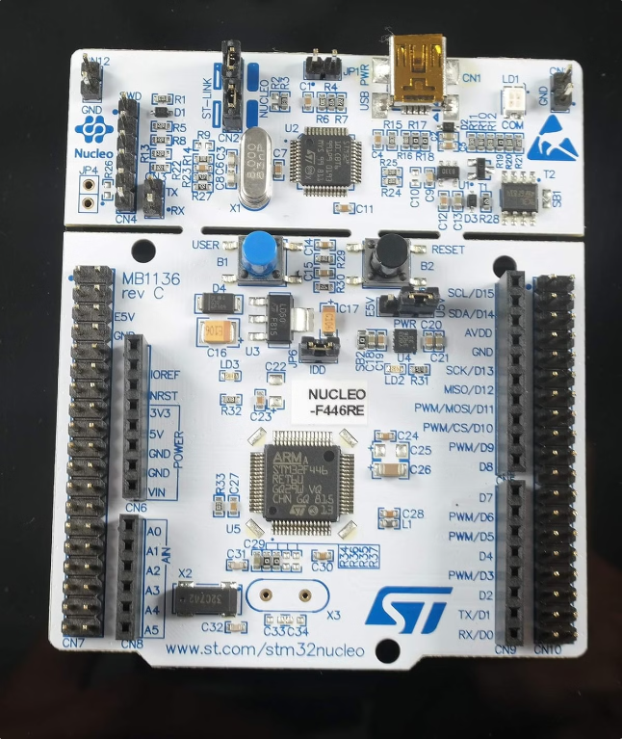
SMART GREEN HOUSE
This project implements a robust temperature monitoring system using the RuggedBoard A5D2X as the master device and two STM32 F446RE microcontrollers as slaves. One slave is responsible for controlling an external device via a relay, while the other slave gathers temperature data from a KY-013 sensor.
BY
AKHIL R
BOOBATHI K

Slide 2
Hardware Components
RuggedBoard A5D2X
STM32 F446RE (Slave 1)
STM32 F446RE (Slave 2)
The RuggedBoard A5D2X serves as the master controller, processing sensor data and managing relay control.
This microcontroller interfaces with the relay, controlling its activation based on temperature readings.
This slave is responsible for reading temperature data from the KY-013 sensor and transmitting it to the master.

Slide 3
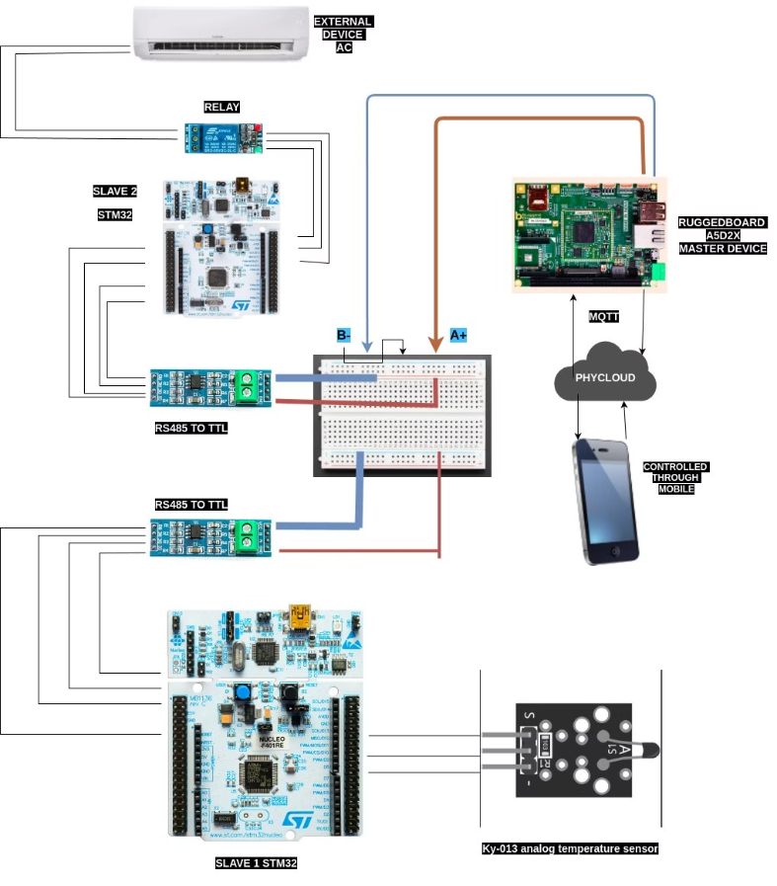
CONNECTION DIAGRAM

Slide 4
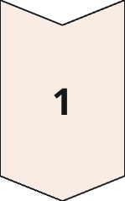
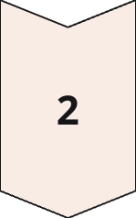
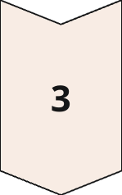
Sensor Integration
Sensor Connection
The KY-013 temperature sensor is connected to the STM32 F446RE slave 2. The sensor outputs an analog voltage proportional to temperature.
Analog-to-Digital Conversion
The STM32 F446RE slave 2 uses its built-in ADC to convert the analog voltage from the sensor to a digital value.
Data Transmission
The digitized temperature data is transmitted from the slave 2 to the master RuggedBoard A5D2X via a communication protocol.

Slide 5
Temperature Monitoring
1
Sensor Reading
The slave 2 microcontroller continuously reads temperature data from the KY-013 sensor.
2
Data Processing
The master RuggedBoard A5D2X receives the temperature data from the slave and performs necessary calculations.
Temperature Display
3
The master displays the current temperature reading on a suitable output device, such as an LCD screen.

Slide 6
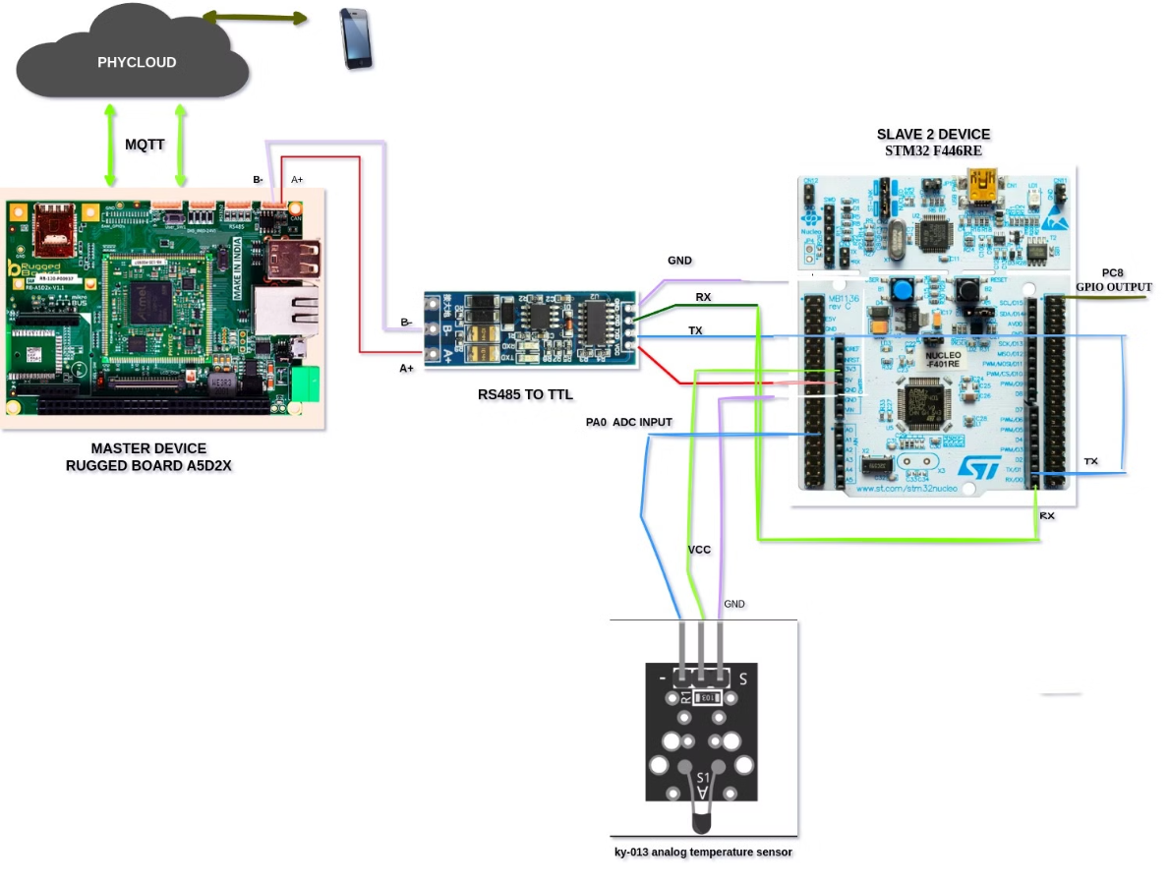
SLAVE 2
LOW LEVEL CONNECTION DIAGRAM OF SLAVE 2

Slide 7





Critical Temperature Threshold
Temperature Comparison
Critical Threshold
Relay Activation
A critical temperature threshold of 25°C is defined for the system.
The master RuggedBoard A5D2X continuously compares the received temperature readings to the critical threshold.
When the temperature exceeds the threshold, a relay activation signal is sent to the slave 1.

Slide 8

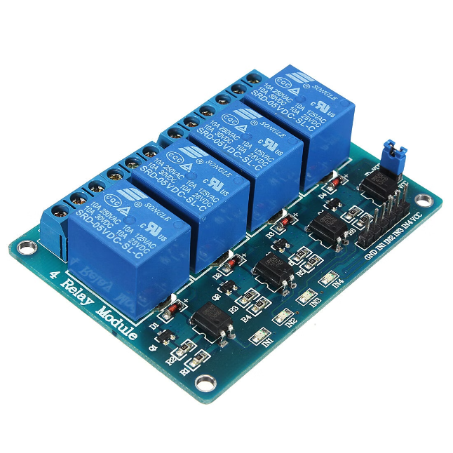
Relay Control Mechanism
1
Relay Trigger
2
Relay Activation
The master RuggedBoard A5D2X sends a control signal to the slave 1 microcontroller when the temperature exceeds the critical threshold.
The slave 1 microcontroller receives the control signal and activates the relay, connecting the external device to power.
External Device Control
3
The activated relay turns on the connected external device, effectively responding to the high temperature condition.

Slide 9
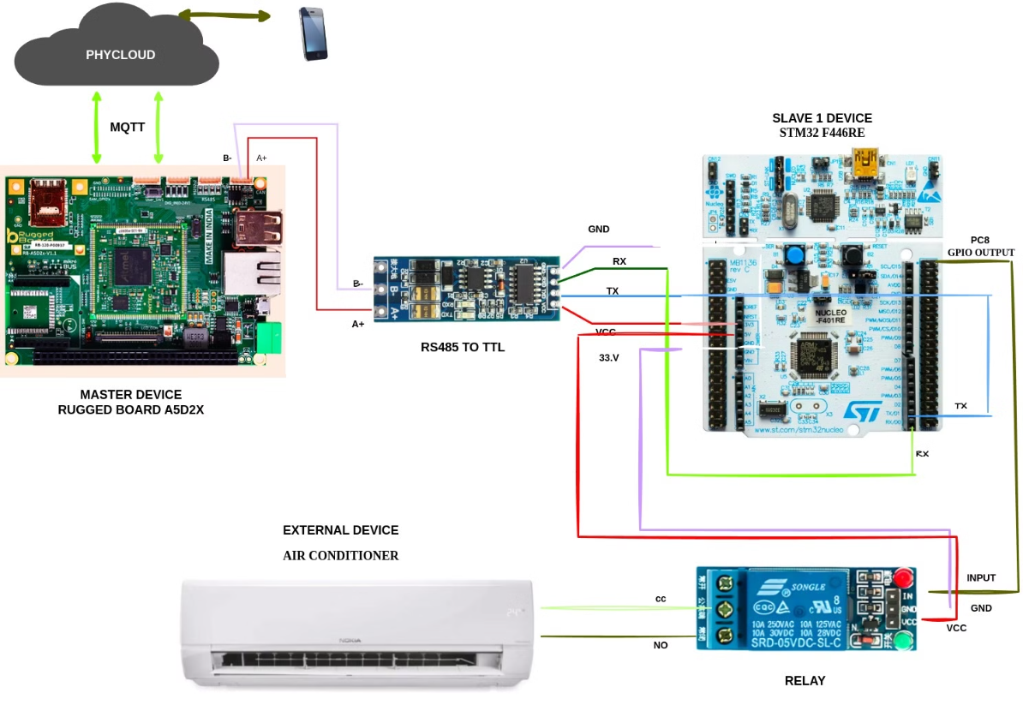
SLAVE 1
LOW LEVEL CONNECTION DIAGRAM OF SLAVE1

Slide 10
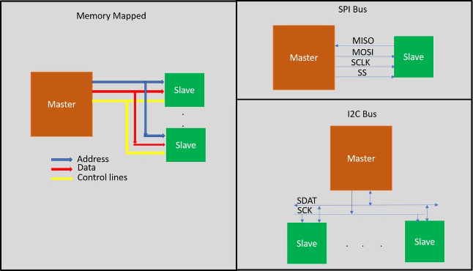
Master-Slave Communication
Master (RuggedBoard A5D2X)
Slave 1 (STM32 F446RE)
Slave 2 (STM32 F446RE)
Sends relay control commands
Receives relay control commands
Sends temperature readings
Receives temperature readings
Activates relay based on commands
Reads temperature data from sensor

Slide 11
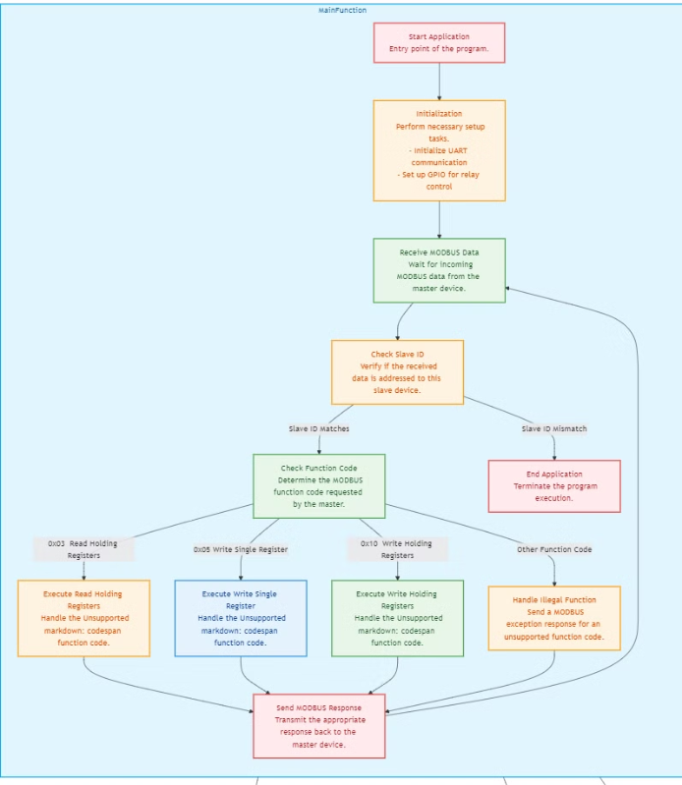
CODE FLOW

Slide 12

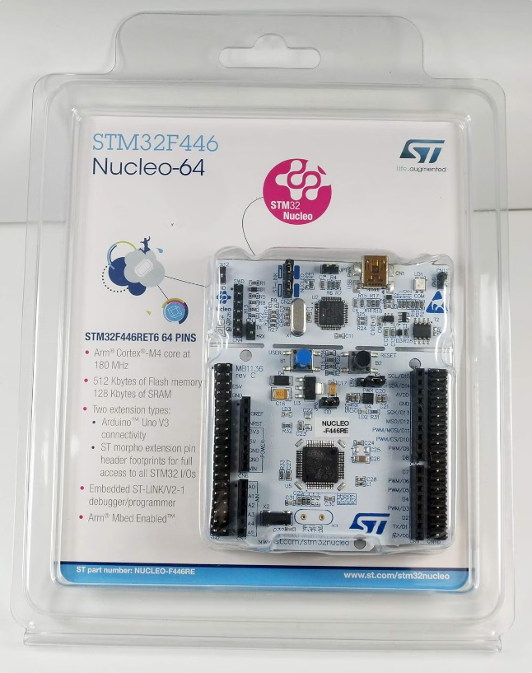
Conclusion
This project demonstrates a comprehensive temperature monitoring system using the RuggedBoard A5D2X and STM32 F446RE microcontrollers. The system effectively monitors temperature, compares it to a critical threshold, and activates a relay to control an external device in response to high temperature conditions. The use of master-slave communication enables efficient data exchange and control between the different components.

Slide 13
THANK YOU

